Slide 1
Working with APIs in Python

Slide 2
REST APIs
REST (Representational State Transfer) is an architectural style for designing networked applications using standard HTTP methods (GET, POST, PUT, DELETE).
Data is treated as resources, accessed via URLs.
REST is simple, stateless, and language-independent.
Each client request must include all necessary information — the server does not maintain session state.
Interactions are resource-centric, with data typically represented in JSON or XML formats.
REST APIs are widely adopted due to their simplicity, language independence, and support for caching layers.

Slide 3





HTTP Verbs
Commands that tell the API what action should be taken on a resource
GET
  Retrieve existing data
POST
  Create new data
PUT
  Create new data or update existing data
PATCH
  Partially update existing data
DELETE
  Delete existing data

Slide 4
HTTP verbs and CRUD operations
CRUD operation | Existing entity | No existing entity
CREATE | Error | POST or PUT
READ | GET | Error
UPDATE | PUT or PATCH | Error
DELETE | DELETE | Error

Slide 5
API Calls in Python
import requests
PUT
GET
POST
DELETE
PATCH
token = 'your_personal_access_token'
headers = {
'Authorization': f'token {token}',
'Accept': 'application/vnd.github.v3+json'
}
GET – retrieve existing data
POST – create a new data
PUT – create new data/update existing data
DELETE – delete existing data
PATCH – partially update existing data

Slide 6
GET Request
GET information about a GitHub account
data = requests.get("https://api.github.com/users/DanielSolomon7").json()
{'avatar_url': 'https://avatars.githubusercontent.com/u/176616955?v=4', 'bio': None, 'blog': '', 'company': None, 'created_at': '2024-07-25T17:57:59Z', 'email': None, 'events_url': 'https://api.github.com/users/DanielSolomon7/events{/privacy}', 'followers': 0, 'followers_url': 'https://api.github.com/users/DanielSolomon7/followers', 'following': 0, 'following_url': 'https://api.github.com/users/DanielSolomon7/following{/other_user}', 'gists_url': 'https://api.github.com/users/DanielSolomon7/gists{/gist_id}', 'gravatar_id': '', 'hireable': None, 'html_url': 'https://github.com/DanielSolomon7', 'id': 176616955, 'location': None, 'login': 'DanielSolomon7', 'name': None, 'node_id': 'U_kgDOCob1-w', 'organizations_url': 'https://api.github.com/users/DanielSolomon7/orgs', 'public_gists': 0, 'public_repos': 4, 'received_events_url': 'https://api.github.com/users/DanielSolomon7/received_events', 'repos_url': 'https://api.github.com/users/DanielSolomon7/repos', 'site_admin': False, 'starred_url': 'https://api.github.com/users/DanielSolomon7/starred{/owner}{/repo}', 'subscriptions_url': 'https://api.github.com/users/DanielSolomon7/subscriptions', 'twitter_username': None, 'type': 'User', 'updated_at': '2025-05-01T11:13:02Z', 'url': 'https://api.github.com/users/DanielSolomon7', 'user_view_type': 'public'}
<Response [200]>

Slide 7
POST Request
Create a new GitHub repository, with a POST request in Python
response = requests.post(
url=f"https://api.github.com/user/repos",
headers={"Authorization": f"token {token}",
"Accept": "application/vnd.github.v3+json"},
json={"name":"a_repo","private":True})
<Response [201]>

Slide 8
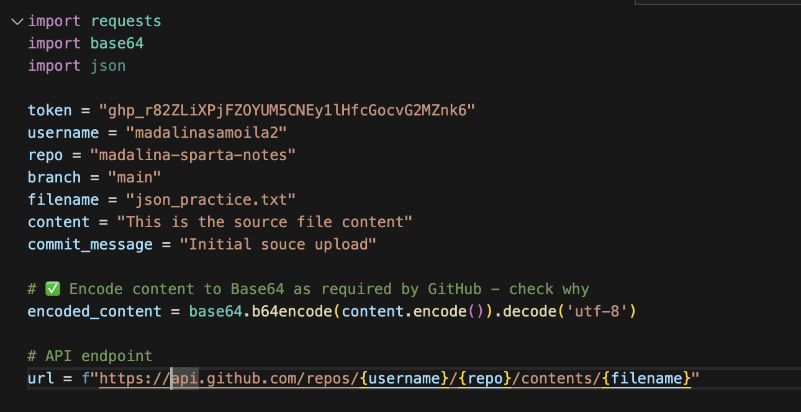
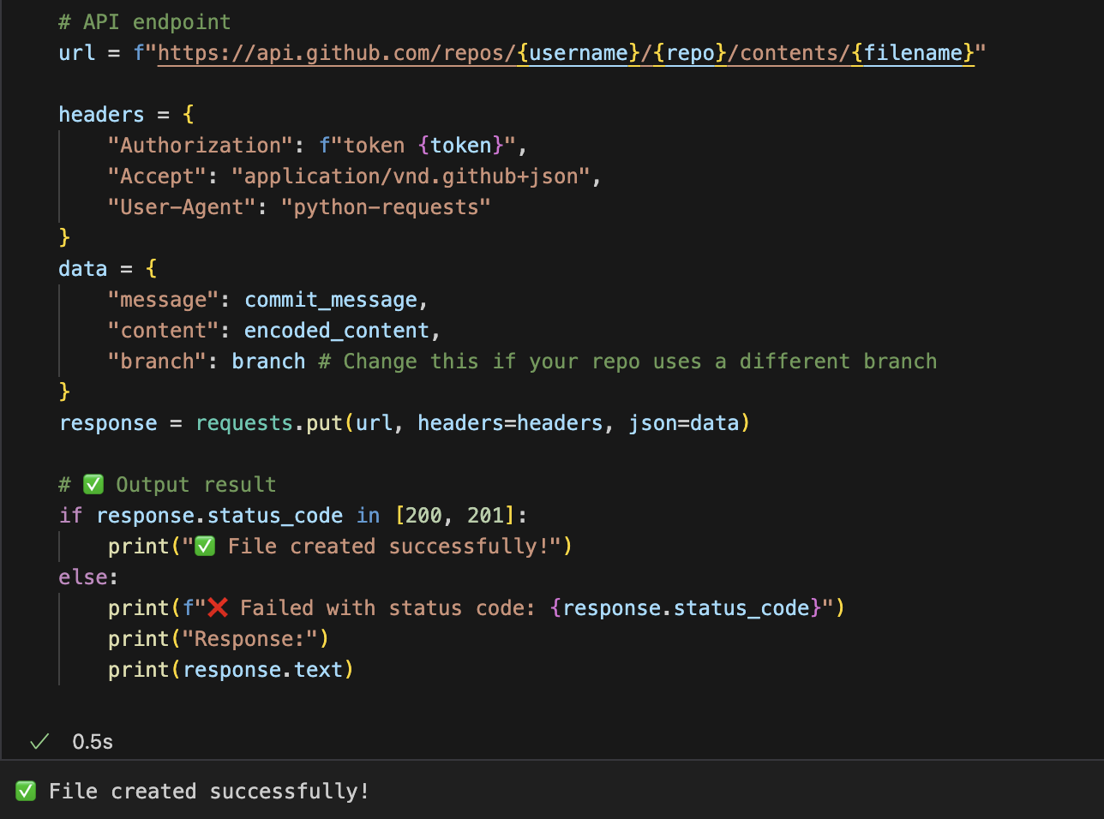
PUT Request
Update a file in a GitHub repository using Python.

Slide 9
DELETE Request
Delete an existing GitHub repository in Python
headers = {
"Authorization": f"token {token}",
"Accept": "application/vnd.github+json"
}
response = requests.delete(f"https://api.github.com/repos/username/repo_name", headers= headers)

Slide 10
Thank you
End of Presentation

